Slide 1
So… What is fine-tuning
Fine-tuning is the process of adapting a pre-trained Large Language Model (LLM) to a specific domain or task by training it on a specialized dataset. This enhances its performance beyond the generic knowledge learned during pretraining. However, full fine-tuning is resource-intensive, leading to the development of Parameter Efficient Fine-Tuning (PEFT) techniques like LoRA (Low-Rank Adaptation) and its optimized variant, Perf-LoRA.
Steps involved in Traditional Fine-Tuning
Load a Pre-trained Model Select a model trained on a general corpus (e.g., GPT-3, BERT, LLaMA).
Prepare a Task-Specific Dataset Collect a dataset relevant to the new task (e.g., medical texts for a healthcare chatbot).
Modify the Model (if needed) For classification tasks, add a task-specific head layer (e.g., softmax for sentiment classification).
Train on the New Data Use gradient descent and backpropagation to adjust the model's weights based on task-specific loss.
Evaluate and Optimize Fine-tune hyperparameters like learning rate, batch size, and regularization techniques (dropout, weight decay).
Deploy the Fine-Tuned Model The final model can now generate domain-specific responses, perform specialized classifications, or complete structured tasks.

Slide 2
Retraining vs Fine-Tuning vs Alt Fine-Tuning
Approach | Retraining (Full Training) | Fine-Tuning | Alternate Methods to Full Fine-Tuning
Definition | Training a model from scratch on a new dataset. | Adjusting a pre-trained model by further training on task-specific data. | Techniques like LoRA, QLoRA, Adapters, and Prompt Tuning that modify only a subset of parameters.
Computational Cost | Extremely high – Requires large-scale GPUs and extensive training time. | Moderate to high – Less costly than full training but still resource-intensive. | Low – Requires minimal trainable parameters, making it efficient.
Knowledge Retention | None – Loses all pre-existing knowledge, must learn everything from the ground up. | Retains prior knowledge while learning new task-specific patterns. | Fully retains prior knowledge and adds adaptations selectively.
Scalability | Difficult – Requires high-end hardware and significant resources. | Scalable – Can be applied to various domains but still resource-heavy. | Highly Scalable – Can fine-tune large models on consumer hardware with minimal cost.
Example Use Case | Building a new LLM like GPT from scratch for a specific industry. | Fine-tuning GPT-4 on a medical dataset to improve diagnosis suggestions. | Using LoRA or Adapters to enhance a chatbot’s responses for legal queries.

Slide 3
Best Use case Scenario
Scenario | Best Approach
You have a large dataset and high compute power | Full Fine-Tuning
You want to adapt a large model on limited hardware | PEFT (LoRA, QLoRA, Adapters)
You need to preserve general model knowledge while adapting | PEFT (LoRA retains original weights)
You are working with small datasets and need quick adaptation | Prompt Tuning / Adapters

Slide 4
Agents tools and frameworks
AI agents are autonomous systems capable of perceiving their environment, making decisions, and executing actions to achieve a goal. They rely on a combination of tools, frameworks, and APIs to interact with data, process inputs, and provide intelligent responses.
Definition | Automation A program that executes predefined rule based tasks automatically | AI Workflow A program that call LLM Api once or more times at different stages | AI Agent A program designed to perform non-deterministic task automatically
Core Foundation | Boolean Logic | Boolean/Fuzzy Logic | Fuzzy Logic/ Autonomy
Strengths | Reliable outcome Fast to execute | Better at handling pattern recognition Great for pattern recognition | Highly adaptive to new variables Simulates human like behaviour
Example | Send a slack notification every time a new lead signs up on our website | Analyse, score and route every website inbound lead using an LLM based API | Perform a full internet search on every inbound lead and update info

Slide 5
Core Components
Perception & Data Retrieval – Agents use APIs and tools to fetch real-time data (e.g., Salesforce, stock prices, or customer records).
Decision-Making – They apply reasoning mechanisms like rule-based systems, search algorithms, or LLM-based reasoning.
Action Execution – They use external tools to perform tasks, such as booking appointments, generating code, or answering queries.
Key Frameworks
Lang Chain – A robust framework for building AI-powered applications with LLMs, offering memory, retrieval, and agent capabilities.
LangGraph – A framework designed for structured, multi-step AI workflows, ideal for graph-based reasoning and agent management. It also has human-in-the-loop facilities.
OpenAI Functions – Provides API-based tools that allow models to call predefined functions for structured task execution.
Llama Index – A framework optimized for LLM-based retrieval, enabling efficient querying over structured and unstructured data.

Slide 6
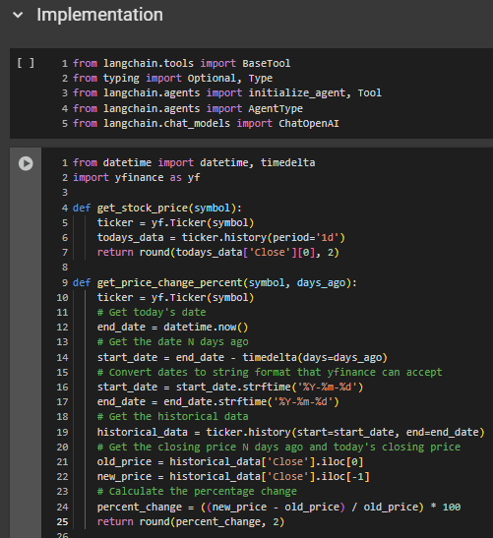
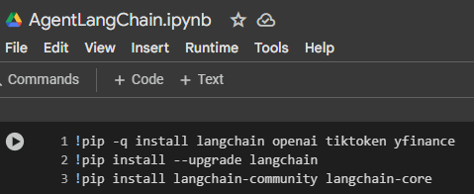
Lets create an Agent then…
1. We start with installing our dependencies
2. We build all our underlying task related functions

Slide 7
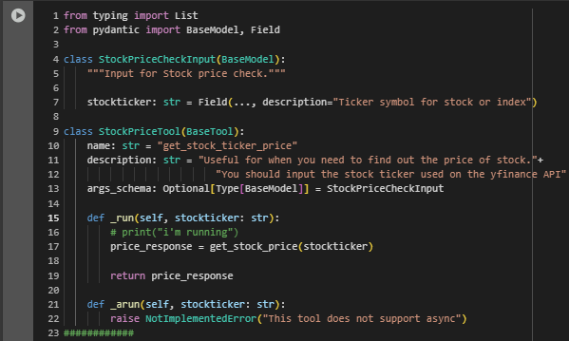
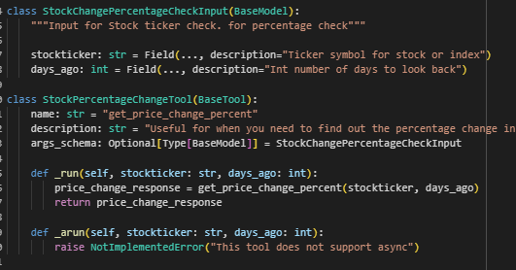
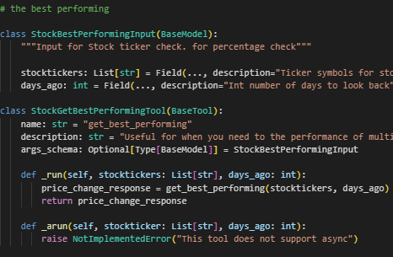
Now we define our 3 sample tools
We need to define our tools and along with their pydantic input validations. Now with the our Agent is ready to proceed.

Slide 8
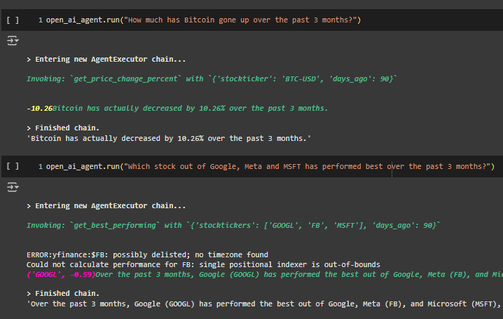
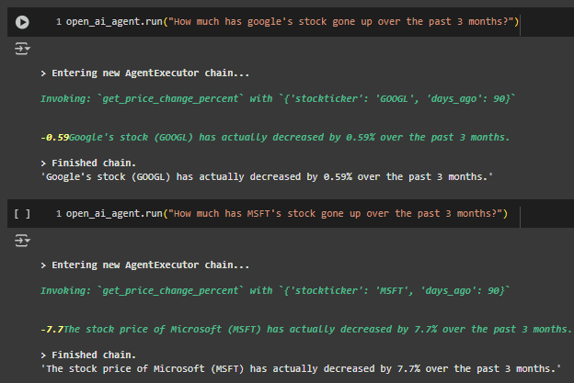
Show Time
Agent takes freeform questions and calls the correct tool(s) as per requirement from its understanding of the name and description of the tools

